Slide 1
English 2 July 13
Max Keenan

Slide 2
Attendance
Think of a funny attendance question.

Slide 3
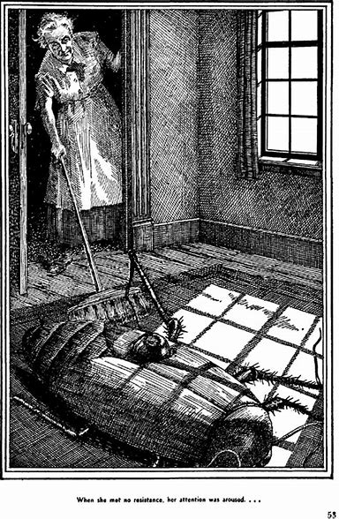
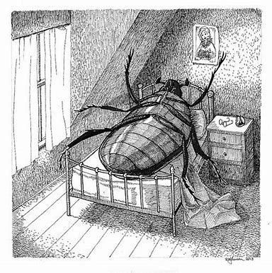
The Metamorphosis

Slide 4
How does Gregor feel about his job?
He has an aversrion to his job. He HATES it!
Cares a lot about his job because his whole family uses his money. He needs to support them.
Traveling salesman (for clothes).

Slide 5
What are Gregor's complaints about his job?
His job is so busy.
Too much work. No time for rest.
Waking up early.
A lot of travel for work.
Terrible boss.

